Slide 1
Celebrating 5 years of the
South African Food Loss and Waste Initiative
Linda Drummond, CGCSA SA FLWI Manager
Notes:
Good morning and thank you for that kind introduction, Kylen.

Slide 2



We are the Consumer Goods Council of South Africa
Transformation, Training and Development
Consumer Goods Crime Risk Initiative
Legal, Regulatory & Stakeholder Engagement
Food Safety and Sustainability Initiative
Global Standards and Solutions
Notes:
GS1 SA, trading as the CGCSA, is an industry association with the core mandate to support & advise the consumer goods sector and advocate on their behalf. Zinhle Tyikwe is the CEO of the CGCSA.
There are various divisions within the organisation. The SA FLWI is an initiative of the FSSI division, which provides thought leadership, guidance and technical support on regulatory aspects of the FMCG value chain with a focus on food safety, quality, nutrition, health and wellness and related matters. This division is led by Matlou Setati.
The CGCSA serves as the ideal secretariat for the SA FLWI, as it represents over 9 000 member companies in the Consumer Goods, Retail and Services sectors, many of whom are food businesses.
I have the privilege of presenting on the progress we have made through this Initiative over the past 5 years. I’d like to ask all the CGCSA team members that are part of this Initiative, as well as those that support this Initiative across the divisions to please stand up or raise your hand. Thank you for the work you have done.

Slide 3

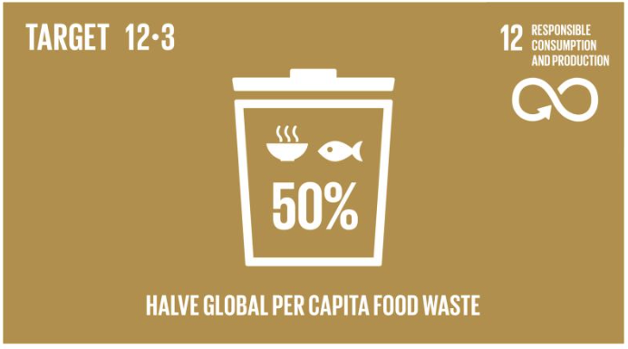


Our vision is to achieve
SDG Target 12.3
Notes:
Today is the 6th commemoration of the IDAFLW, which seeks to promote awareness and collective action to reduce FLW. It was on this day 5 years ago in this very place that the SA FLWI was established, in partnership with the dtic and the DFFE, after several dialogues that involved more than 500 stakeholders in the food value chain. I would like to ask any members from the DFFE and the dtic to please stand up or raise your hand. Thank you for your partnership.
Our vision is to achieve the SDG 12.3, which is to “halve per capita global food waste at the retail and consumer levels and reduce food losses along production and supply chains” by 2030.

Slide 4
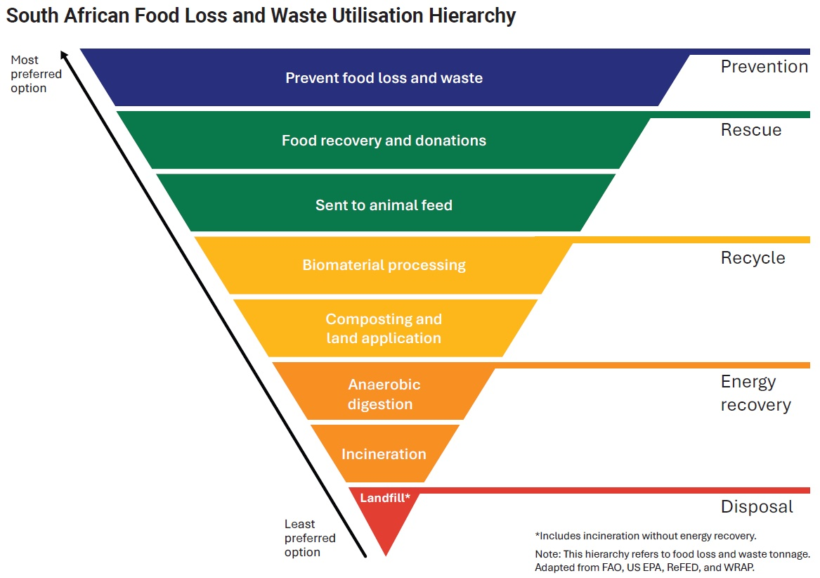

By adopting the SA FLW Utilisation Hierarchy & identifying solutions that are based circular & a sustainable food systems approach
Notes:
We are doing this by working with stakeholders across the value chain to adopt the SA FLW Utilisation Hierarchy, which you can see on the screen.
Our primary goal is to improve food utilisation and to prevent FLW from happening in the first place. This is the blue area at the top of the hierarchy.
Our second goal is to redistribute of edible, nutritious food to people, which is the first green bar under the blue prevention bar.
Thirdly, we are working to move food from waste destinations at the bottom of the hierarchy to non-waste destinations at the top of the hierarchy, that represent secondary markets for surplus food.
We are also working to identify solutions that are based on a circular and sustainable food systems approach.

Slide 5
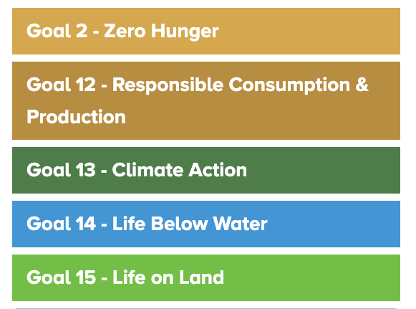

FLW prevention & reduction can help transform our food system
Notes:
Preventing and reducing FLW can help transform the global food system, as achieving SDG Target 12.3 would assist in achieving several other of the SDGs, including those relating to hunger, climate change, life on land and life below water to name a few.

Slide 6

10.3 million tonnes
Of all food in South Africa is wasted each year
80% of which is edible
Notes:
According to the latest report published by the Council for Scientific and Industrial Research (CSIR) in 2021, 10,3 million tonnes of food is wasted in South Africa each year, 80% of which is edible.

Slide 7
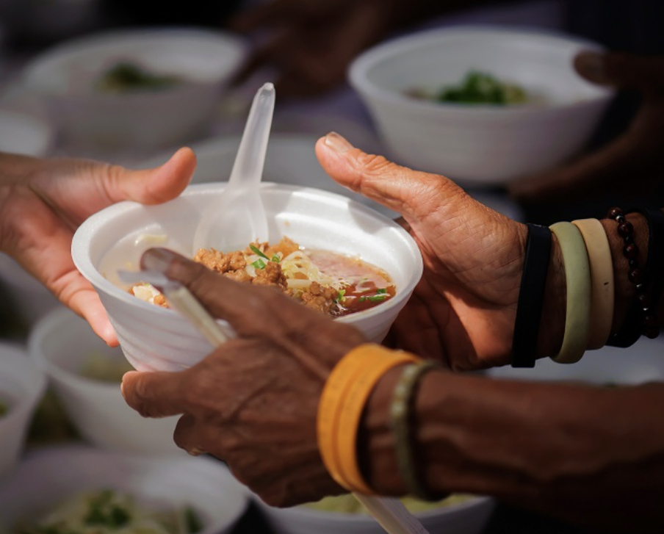
This food could provide 3 meals a day to half the people in South Africa for a year
Notes:
This could provide 3 meals a day to half the people in South Africa for a year. Imagine that!
South Africa produces sufficient food for all South Africans, yet many people are vulnerable to or are experiencing hunger each day.
Reducing waste by redirecting surplus food to vulnerable people can help feed millions of food-insecure South Africans, improve food security, nutrition and health.

Slide 8
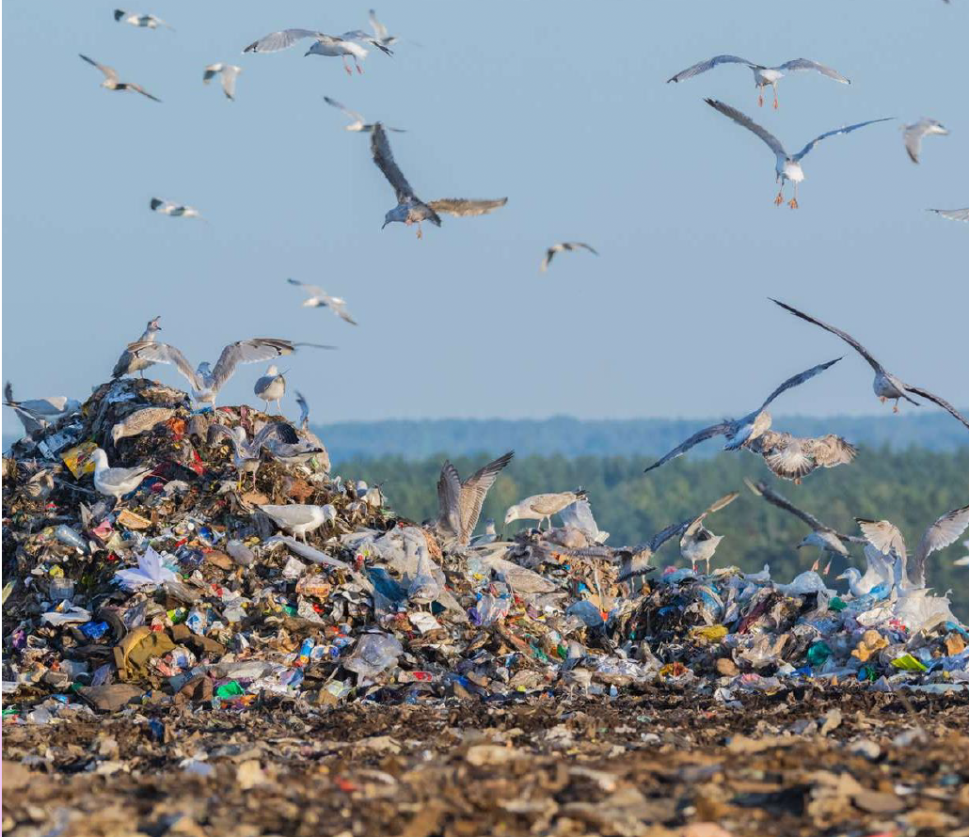
Tackling FLW will reduce greenhouse gas emissions, protect natural resources & biodiversity
Notes:
According to UNEP in 2024, FLW generates 8 – 10% of annual global greenhouse gas emissions – almost 5 times that of the aviation sector – and contributes to significant biodiversity loss by taking up the equivalent of almost a third of the world’s agricultural land.
Food waste is a major contributor to climate change, and its environmental impact in South Africa is considerable. When we discard food, we’re not just wasting the edible produce itself; we’re also squandering all the energy, water and fuel expended in its journey to our plate.
Land used for food production needs various inputs which has an impact on ecosystems. Overuse of land and resources affects natural habitats and biodiversity.
Moreover, food rotting in landfill sites produces methane, a potent greenhouse gas.
By preventing and reducing FLW, we can drastically reduce our environmental impact, preserve natural habitats and biodiversity, and build a sustainable and resilient food system.

Slide 9
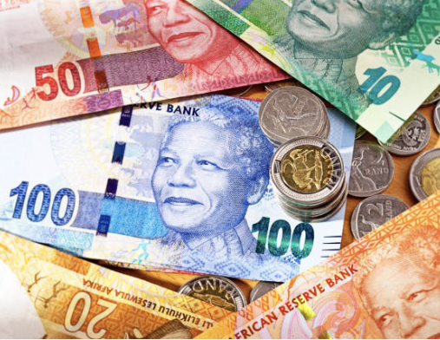
Following circular economy approaches can create jobs, improve livelihoods and generate financial benefits for a range of stakeholders
Notes:
Following circular economy approaches in our food system to prevent, reduce, reuse and repurpose FLW can create new job opportunities, improve livelihoods and generate financial benefits for a range of stakeholders. We need this in South Africa. For businesses this is key to managing risk and driving efficiencies. Doing things differently through new business models allows businesses to realise greater economic benefits, attract investment and help build a resilient economy.

Slide 10
Together, we have made significant progress
Over the past 5 years
Here are our reasons to celebrate
Notes:
Knowing that tackling FLW is a triple win, for people, for the planet and for profit, and by taking collective action, together we have made significant progress over the past 5 years, here are our reasons to celebrate…

Slide 11
4
Team members +
1 In-Country Impact Lead + Support
Consumer Goods Council of South Africa, 2025
Notes:
Firstly, we now have a team in place to drive this work. Boitumelo, Taahirah, Sibulela and Kylen, could you please stand or raise your hand, as well as Nicola who is our in-country WRAP South Africa Impact Lead. She is supported by Clinton Nesengani, who is not here today.

Slide 12
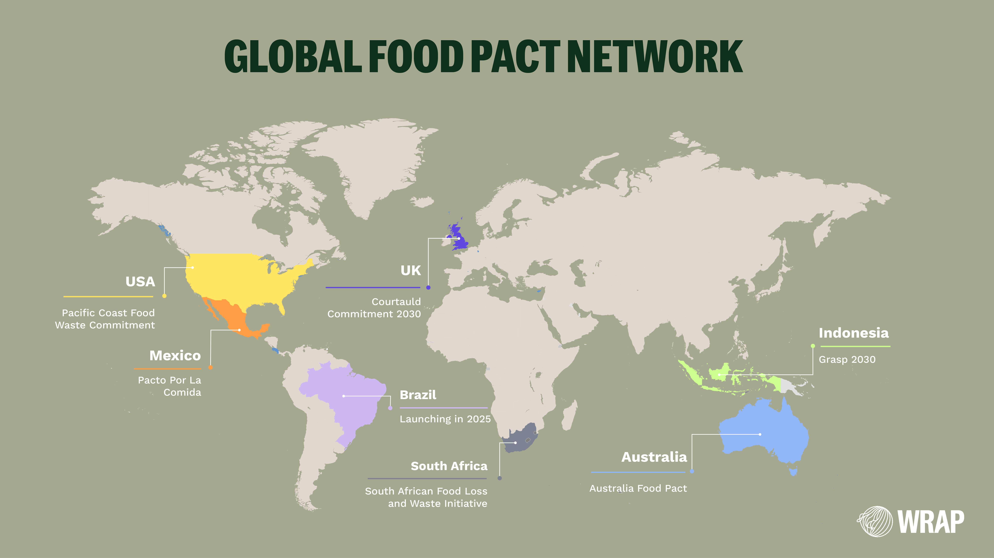
Notes:
Secondly, we are officially on the map! The SA FLWI is open to all (members and non-members) and has received limited funding over the years to support this work. In 2024, we were awarded funding from the Ballmer Group through the Waste and Resources Action Programme (WRAP), who we had been collaborating with since the launch of the Initiative. This funding has allowed us to work together with other similar initiatives across the globe as part of the Global Food Pact Network and to significantly scale the work of the Initiative over the past year. WRAP is a strategic partner to the SA FLWI and we welcome John Eaglesham who has joined us from the WRAP International Team today, if you could please stand up or raise your hand. Thank you for your partnership.

Slide 13
Our work spans across three areas
Partners
People
Policy
Notes:
Our work spans across three areas: Partners, People and Policy.

Slide 14
~44%
of the formal food value chain is represented by our core signatories
Bureau of Food & Agricultural Policy, 2025
Notes:
From a Partners perspective, we are on our way to being representative of the food system in South Africa. According to the recent representation analysis conducted by BFAP, ~44% of the formal food value chain is represented in the SA FLWI and all the major retailers are on board. Most of our signatories are at the manufacturing and processing stage of the food value chain and it is estimated that around 50% of this stage is represented. We will be unpacking this representation analysis with our signatories before the end of November this year.

Slide 15






























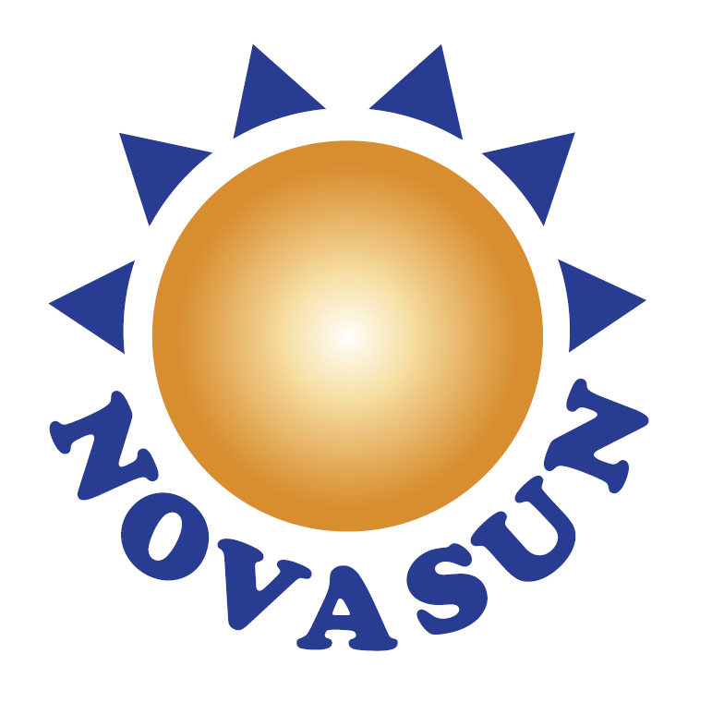






























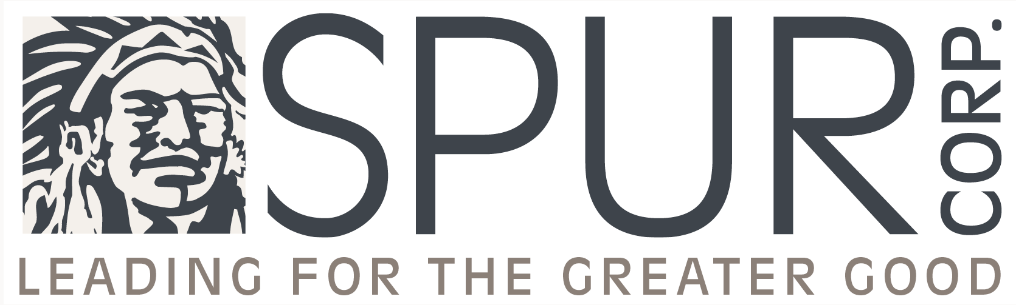


Food businesses working to reduce FLW
Blue Shirt Bakeries, Coach House Confectioneries, CSG Group, Darling Cellars, Kakhulu Brands, Kees Beyers Chocolate, Lebombo Cape Properties, Madron Farming, Tonop Kitchen
Notes:
We currently have 78 core signatories. These are food businesses that are working towards preventing and reducing food loss and waste in their operations. If you are a core signatory here today, please stand up or raise your hand. Thank you for the work you are doing.

Slide 16



























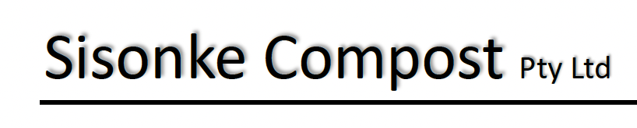























FLW solutions + services in our network
Brightwolves, Envirosense, Phend Pharma, Philafeed
Notes:
We currently have 57 associate signatories. These are organisations of various types that can assist core signatories prevent and or reduce food loss and waste. They include solution and service providers of various kinds, academia, NGOs and government. If you are an associate signatory here today, please stand up or raise your hand. Your solutions and services are key to solving the issue of FLW.

Slide 17
1st country
To create an online reporting platform based on the FLW Standard
Consumer Goods Council of South Africa, 2023
Notes:
We know that what we can’t manage what we don’t measure. We are the first country in our network to create an online reporting platform based on the international FLW Standard. The CGCSA’s GSS team were instrumental in making this a reality. If you are here from the GSS team, please stand up or raise your hand. Thank you for your support.

Slide 18
59
Signatories have submitted data over 4 years with 22 submitting data each year
Council for Scientific & Industrial Research , 2025
Notes:
The CSIR have analysed the anonymised data received from our signatories from 2021 to 2023 and the data for 2024 is going through a quality review process internally.
59 signatories have submitted data over 4 years, with 22 submitting data each year.
Over the past four years of data reporting and submissions, there has been a consistent increase in hotspot analysis, target setting, and specific intervention activities across signatories, which shows the value of measurement as a tool for driving improved management. We will also be unpacking this analysis with our signatories before the end of November this year. If you are from the CSIR and are here today, please stand up or raise your hand. Thank you for the work you have done.

Slide 19
22
Signatories have submitted action plans this year
Consumer Goods Council of South Africa, 2025
Notes:
22 signatories have submitted action plans this year, which allow the SA FLWI team to provide signatories with technical support and guidance in real time. If you are a signatory here today that has submitted an action plan, please stand up or raise your hand. Thank you.

Slide 20
1st ever
Digital FLW consumer awareness campaign launched
Consumer Goods Council of South Africa, 2025
Notes:
According to the CSIR, 18% of food waste in South Africa occurs at the consumption stage of the value chain.
From a People or South African citizens perspective, we have launched our first ever digital FLW consumer awareness campaign.

Slide 21
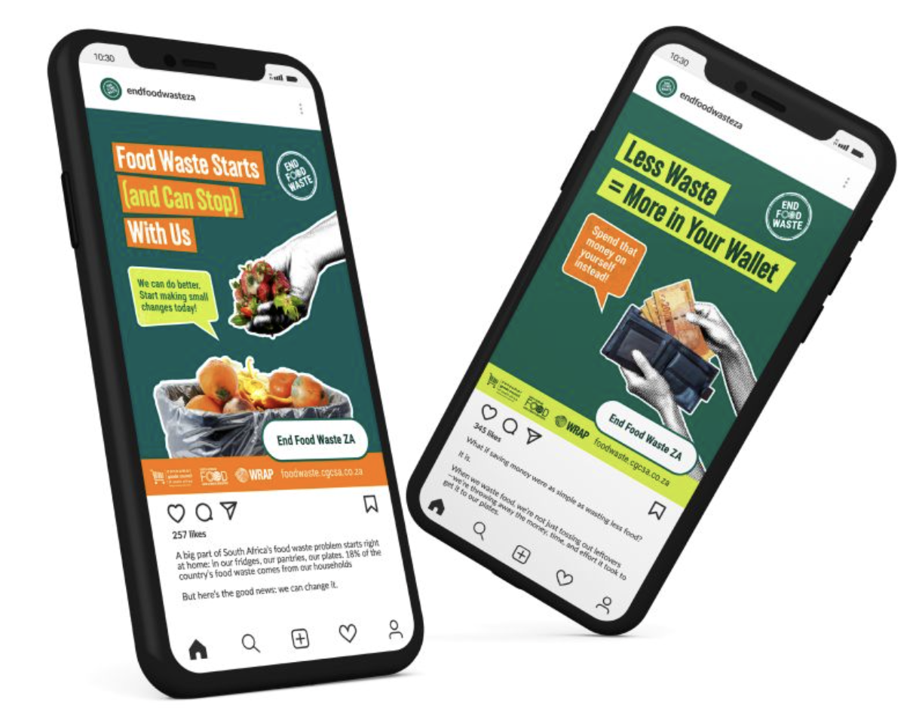
End Food Waste ZA – Be part of the change
Instagram: @endfoodwasteza
Facebook: End Food Waste ZA
Campaign landing page:
https://foodwaste.cgcsa.co.za/
Notes:
This campaign is called End Food Waste ZA and Kylen leads this amazing work.
We invite you to be part of the change at household level, visit and interact with these pages, and follow us.

Slide 22
End Food Waste ZA – August Impact
> 9000 visits to our campaign landing page with +30% engagement rate & session duration of 1 minute
731 downloads of materials from this page
1839 Facebook followers
128 Instagram followers
Notes:
The following metrics show excellent engagement over a short period of time, as of Friday last week we had:
9,027 visits to our campaign landing page backed by impressive results like a 30%+ engagement rate and an average session duration of 1 minute
731 downloads of materials from the landing page
1,839 Facebook followers with 8,370 interactions
128 Instagram followers with 614 interactions
Watch this space as the campaign continues until the beginning of November this year.

Slide 23
South African
consumer research
Underway to gather insights to inform behaviour change campaigns
Waste & Resources Action Programme, 2025
Notes:
We are in the process of doing research among ~2000 South Africans to gather insights to inform a behaviour change campaign in 2026. Results of this research, including a consumer segmentation analysis, will be available in November this year.

Slide 24
The National Strategy
For reducing food losses and waste published
Department of Environment, Forestry and Fisheries, 2025
Notes:
From a Policy perspective, the DFFE have published the first national strategy for reducing food losses and waste in South Africa, which indicates that this issue is a matter of national importance.

Slide 25
Our food donation guidelines
Have been used to develop a
South African National Standard
Consumer Goods Council of South Africa, 2025
Notes:
Our food donation guidelines, which are an output of our Food Donation Working Group, have been used to develop a Food Donation and Redistribution Best Practice Standard.

Slide 26
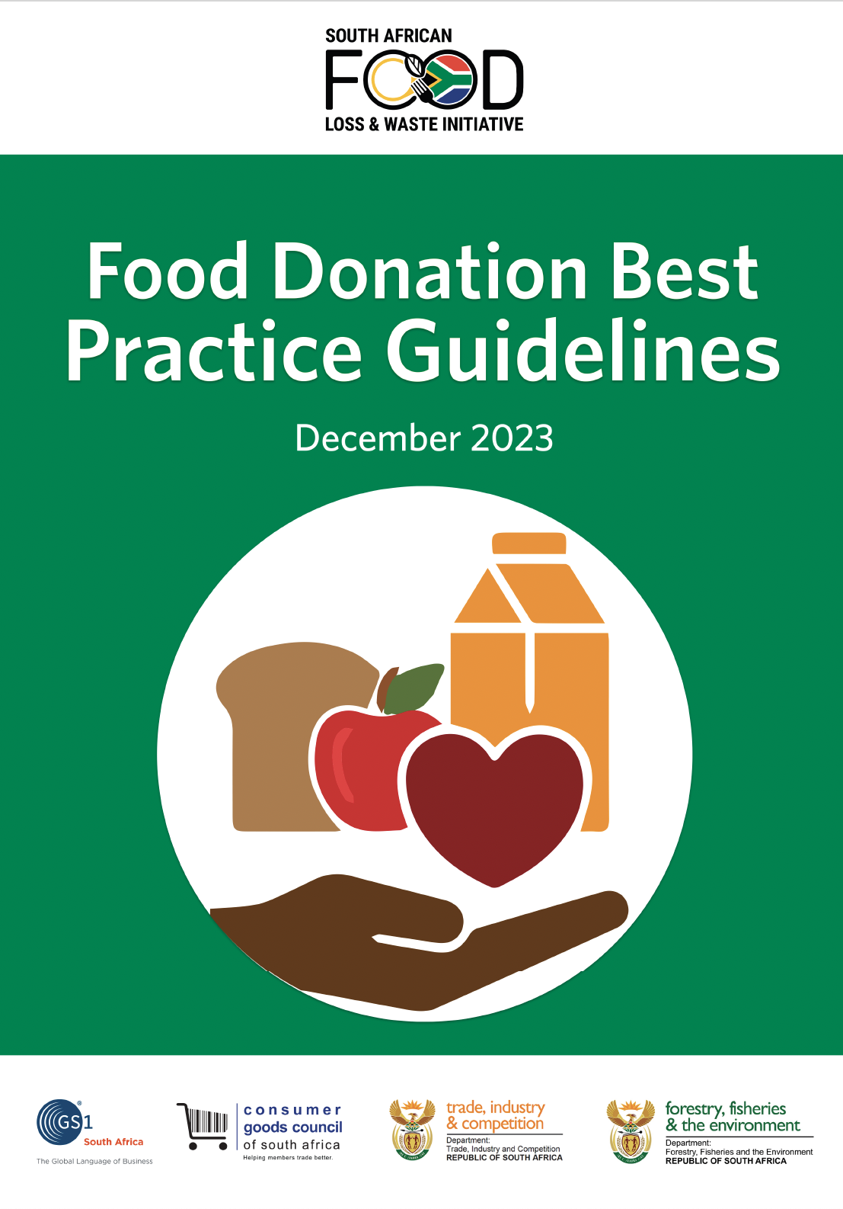
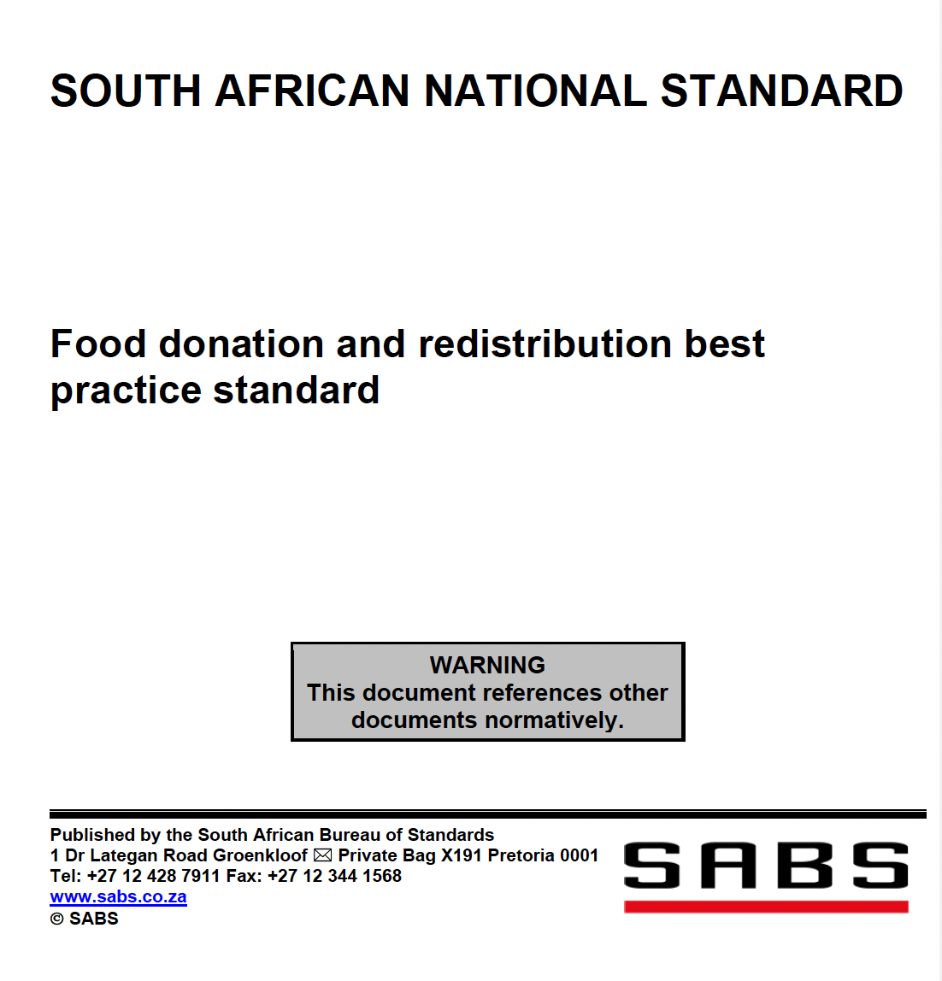
Notes:
These guidelines have been updated again this year and will be made available shortly. We are also expecting the national standard to be published for public comment soon. Sibu is leading the working group and Precious, our Food Safety & Quality Pillar Lead, is representing us in the SABS Technical Committee that have written the standard. Please stand up or raise your hand. Thank you.

Slide 27
Animal feed guidelines
Are under development through a new working group
Consumer Goods Council of South Africa, 2025
Notes:
Sending surplus food to animals for feed is the second preferred non-waste destination on the FLW hierarchy, below sending food to people.
Currently, there is no clear guidance on:
what types of food waste can be sent to animals (from an animal safety perspective),
the associated legislation that needs to be adhered to, and
who ensures compliance with the legislation.
The Animal Feed Working Group aims to develop a set of guidelines that can be used to enable and facilitate the diversion of surplus food (that is not fit for human consumption) but that is suitable for animals, to animals as feed.
Taahirah is leading this work.

Slide 28
We are developing social, environmental + financial business cases to retain and attract missing sectors
There will be continued measurement + reporting + action at a signatory level
We will launch two impact interventions to drive collective action (organic waste and GS1 2D barcode pilots)
There will be specific associate signatory engagement to ensure core signatories have the solutions + services they need
Driving impact in 2026
Notes:
2026 promises to be an impactful year. The following key actions are planned to drive significant prevention and reduction in food loss and waste in South Africa:
We are developing, social, environmental + financial business cases to retain and attract missing sectors.
There will be continued measurement + reporting + action at a signatory level.
We will launch two impact interventions to drive collective action (one focused on organic waste at municipal level, and the other being a GS1 2D barcode pilot).
There will be specific associate signatory engagement to ensure that core signatories have the solutions and services they need to prevent and reduce food waste.

Slide 29
We will undertake a consumer behaviour change campaign
We will launch a website as a resource hub
We will recruit additional people to support this work
A future proofing strategy and implementation plan for the SA FLWI will be put in place
Driving impact in 2026
Notes:
We will undertake a consumer behaviour change campaign.
We will launch a website as a resource hub.
We will recruit additional people to support this work.
A future proofing strategy and implementation plan for the SA FLWI will be put in place to ensure that this work is sustainable.

Slide 30

Food is a symbol of togetherness. It connects us.
Image: Food Lover’s Market Heritage Day advertisement
Notes:
Food is a symbol of togetherness in South Africa. It is part of our culture and our heritage, and it connects us. It is precious and we need to treat it that way.

Slide 31
Every action taken to reduce food loss and waste matters!
Every action taken to reduce food loss and waste counts
Food and Agriculture Organisation of the United Nations, 2025
Notes:
Today many people have stood up or raised their hands indicating the part they are playing. It has been said that this is a bit like a ‘bring and braai’. Every action taken to prevent and reduce FLW counts, join us and bring your contribution to the table. It is going to take all of us working together to make a difference. Our collective action will drive the transformation to a more efficient, inclusive, resilient, and sustainable food system for better production, better nutrition, a better environment, and a better life, leaving no one behind.

Slide 32

Here’s to the successes over the past 5 years, will you join us on the journey over the next 5 years as we reach 2030?

Slide 33
Thank you for being part of transforming our food system for the better
To join the SA FLWI or to find out more, please contact us at: flw.initiative@cgcsa.co.za
Notes:
The CGCSA, in partnership with the Department of Trade, Industry and Competition (the dtic) and the Department of Forestry, Fisheries & the Environment (DFFE), gratefully acknowledge the Ballmer Group's funding, provided through the Waste and Resources Action Programme (WRAP), which has made this work possible.

